Slide 1
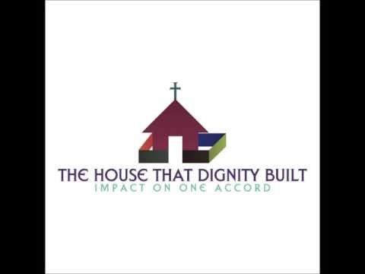
‘Piece’ be still for praise is my weapon
Dr. Daintee g. Jones – the house that dignity built
Lesson activity – November 15, 2016

Slide 2
Table of contents
Sermon location
Thesis statement
Points 1-3
Your turn
Resources

Slide 3
Sermon, lesson & transcript location
YouTube location - https://www.youtube.com/watch?v=TC7_wA-50KM
Dignity house lesson activity location - http://www.dignityshouse.org/lesson-activities.html
Dignity transcript location - https://dignityjobs.wordpress.com/

Slide 4
Thesis statement
“The word shows that praise is linked to God’s vision, God’s reason for creating the world, and to God’s protection” – (Jones, 2016, p. 3)

Slide 5
Point 1 – god’s voice
Scripture
Psalm 95: 6-7
Assertion
Praise lets people hear God’s voice.
⁶ Come, let us bow down in worship, let us kneel before the Lord our Maker; ⁷ for he is our God and we are the people of his pasture, the flock under his care.
Today, if only you would hear his voice,

Slide 6
Point 2 – god’s intention of creation
Scripture
³⁸ Blessed is the king who comes in the name of the Lord!”^{[b]}
Assertion
Praise is a reason that God’s kingdom exists.
“Peace in heaven and glory in the highest!”
³⁹ Some of the Pharisees in the crowd said to Jesus, “Teacher, rebuke your disciples!”
⁴⁰ “I tell you,” he replied, “if they keep quiet, the stones will cry out.

Slide 7
Point 3 – god’s protection
Scripture
Psalm 20: 6-9
Assertion
Praise brings protection.
⁶ Now this I know: The Lord gives victory to his anointed. He answers him from his heavenly sanctuary with the victorious power of his right hand. ⁷ Some trust in chariots and some in horses, but we trust in the name of the Lord our God. ⁸ They are brought to their knees and fall, but we rise up and stand firm. ⁹ Lord, give victory to the king! Answer us when we call!

Slide 8
Point 3 – god’s protection cont.
Scripture
2 Chronicles 20: 22
Assertion
Praise brings protection.
²² As they began to sing and praise, the Lord set ambushes against the men of Ammon and Moab and Mount Seir who were invading Judah, and they were defeated.

Slide 9
Your turn
God’s voice
What is your favorite scripture about praise?
What does it suggest about God’s desire for us?
God’s creation
What inanimate or non-human creations show praise to God?
How do these items show praise?
God’s protection
What is a name that God uses to show that He is a protector?
What is the book, chapter, and verse of the scripture that you chose as evidence of this?

Slide 10
resources
Holy Bible
Jones, D. (2016). ‘Piece’ be still for praise is my weapon. The House That Dignity Built. Retrieved at dignityjobs.wordpress.com, November 2016.

Slide 11
contributors
Pastor Sola Adele – Cross2Freedom Ministries
House that Dignity Built scriptural supporters:
Brother Bobby Felder
Sister Vanessa M.
Sister Jacqueline G.
Sister Ramona B.

Slide 12
The end

