Slide 1
Righteous dignity self Health & self care panel discussion
The Dignity in direction group
Righteous royalty ministries

Slide 2
prayer
Brother Lamon Honeycutt

Slide 3
Welcome & introductions
Dr. Daintee Jones
Brother Lamon Honeycutt
Sister Cutina Honeycutt
Dr. Stephanie Plain Potter

Slide 4
Program’s purpose
Sister Cutina Honeycutt
To testify to the goodness of implementing self care habits
To discuss barriers to self health

Slide 5
Self care area definitions – Dr. Plain potter
Psychological
Physical
Emotional
Financial
Environmental
Spiritual
Social
Professional Development

Slide 6
Self care data
Most?
Least?

Slide 7
Eight testimonials on self care

Slide 8
Psychological – Brother honeycutt
Proverbs 2:10
¹⁰ For wisdom will enter your heart, and knowledge will be pleasant to your soul.

Slide 9
question - psychological
How do I take care of my mental health?

Slide 10
Physical – Sister honeycutt
1 Cor. 10:31
³¹ So whether you eat or drink or whatever you do, do it all for the glory of God.
3 John 1:2
² Dear friend, I pray that you may enjoy good health and that all may go well with you, even as your soul is getting along well.

Slide 11
question - physical
When should you change up your self care routine?

Slide 12
Financial – Dr. plain potter
Philippians 4:19
¹⁹ And my God will meet all your needs according to the riches of his glory in Christ Jesus.

Slide 13
Question - financial
What is the best way one can master self care?

Slide 14
Environmental – Dr. Daintee
Psalm 24:1
The earth is the Lord’s, and everything in it, the world, and all who live in it;

Slide 15
Question - environmental
How can self care be implemented into a 40-60 hours work week?

Slide 16
Emotional – Brother honeycutt
Psalm 147:3
He heals the brokenhearted and binds up their wounds.
1 Peter 5:10
¹⁰ And the God of all grace, who called you to his eternal glory in Christ, after you have suffered a little while, will himself restore you and make you strong, firm and steadfast.

Slide 17
Question - emotional
Can you feel differently from someone else even if they attend to their self care the same that you do?

Slide 18
Spiritual – Sister honeycutt
Proverbs 3:5-6
Trust in the Lord with all your heart and lean not on your own understanding; ⁶ in all your ways submit to him, and he will make your paths straight.^{[a]}
Romans 15:14
Trust in the Lord with all your heart and lean not on your own understanding; ⁶ in all your ways submit to him, and he will make your paths straight.^{[a]}

Slide 19
Question - spiritual
How can my spiritual care improve my wellness?

Slide 20
Social – Dr. plain potter
Ecclesiastes 4:9
Two are better than one, because they have a good return for their labor:
Romans 12:16
Two are better than one, because they have a good return for their labor:

Slide 21
Question - social
What is the best way to balance self care and one’s regular life?

Slide 22
Professional Development – Dr. Daintee
Proverbs 1:5
let the wise listen and add to their learning, and let the discerning get guidance—

Slide 23
Question – professional development
What made you start your self care journey?

Slide 24
What are you saying?
Dr. Stephanie Plain Potter, LPC, NCC, CCC

Slide 26
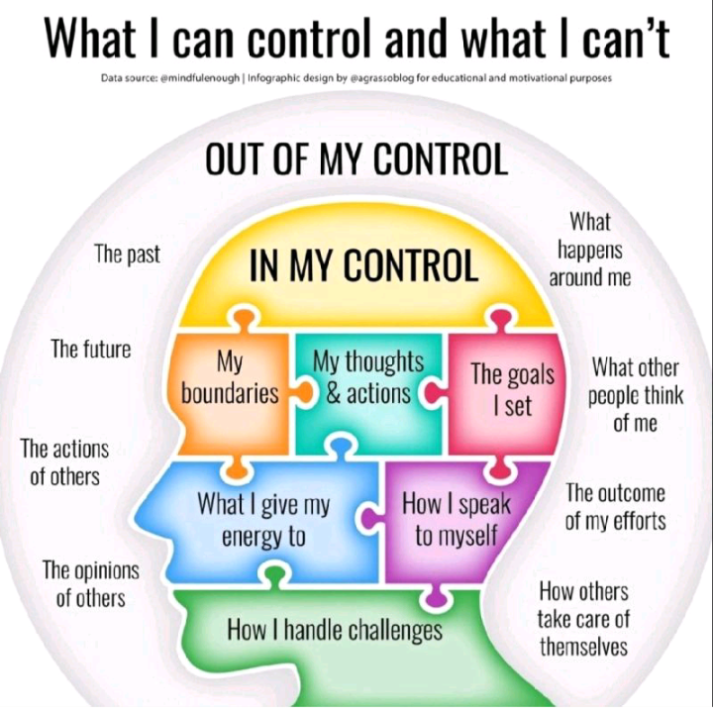

Slide 28
Questions & gifts

Slide 30
Contact us!
The Dignity in Direction Group
www.dignityshouse.org
YouTube – Daintee Jones
832-862-6765

Slide 31
Closing prayer
Sister Honeycutt

